Slide 1
MTPA Control using HF Signal Injection
Connor Ricotta

Slide 2
MTPA Control
Maximum Torque Per Ampere
Goal is to produce the maximum torque while minimizing draw from power source
Primary goal is to improve overall efficiency of the motor
Reduced current draw leads to reduced energy consumption and reduced temperature
Especially helpful in automotive applications
Less current leads to smaller gauge wire reducing the weight, leading to further efficacy improvements
Smaller battery needed to go same distance

Slide 3
Problems with MTPA
Motor performance and parameters will not perfectly align to spec sheets or stay constant over its lifespan
Especially true as conditions change (i.e. different operating temperatures)
Poor performance with non-linear systems and outside specific operating ranges
Struggles at very low and high speeds due to this
Even if high precision sensors are used, they can suffer from noise or some inaccuracy

Slide 4
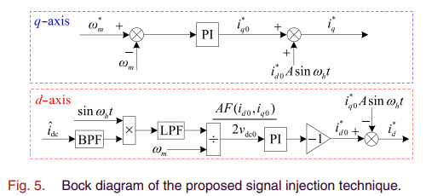
Proposed Solution
Use high frequency sinusoidal signals to correct the calculated reference currents

Slide 5
How this solution works
By improving parameter estimation, you improve stability
Less error results in a less aggressive response
Many parameters allow you to tune to the specific conditions of your motor
Extracts MTPA indicator from dc-link current rather than using motor speed
This avoids the requirement of high precision speed or voltage sensors
Rather than injecting as polar coordinates, injects directly into d and q currents
This avoids needing to complete coordinate transforms

Slide 6
Concerns
Stability seems to be a problem with this method
Tuning can be difficult
Many parameters to tune, if any are off can lead to more error for parameter estimation
The recommended frequency seems to be very low
Needed to apply similar filtering from id to iq for good results
Iq would be zero otherwise and would result in only half the torque achieved

Slide 7
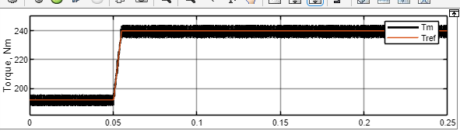
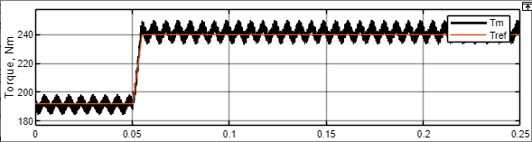
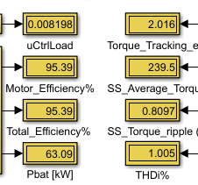
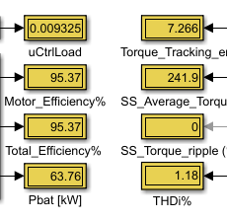
Results: 10KHz
Original Signal Injection

Slide 8
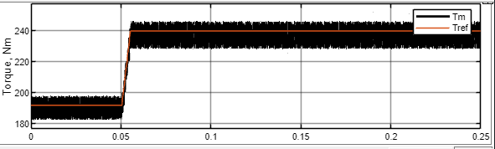
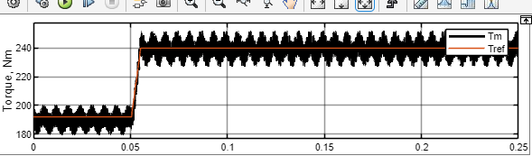
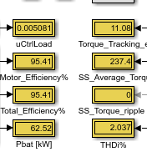
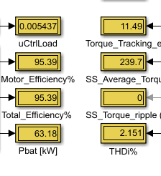
Results: 20KHz
Original Signal Injection

Slide 9
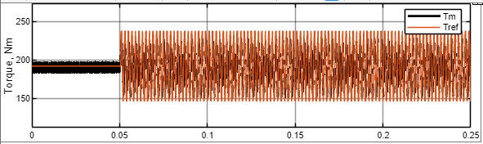
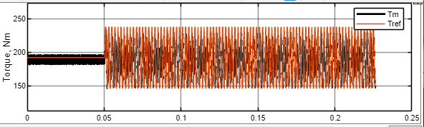
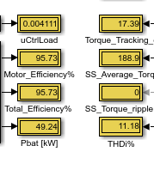
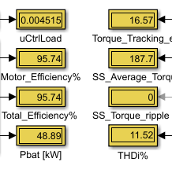
Results: Sinusoidal reference &improved parameter
Original Signal Injection

Slide 10
Future Work & Changes to be made
Continue tuning and find optimal parameters
Comparison between the recommended PI controller and an MPC Controller
Apply their current minimization strategy

Slide 11
References
K. Li and Y. Wang, "Maximum Torque per Ampere (MTPA) Control for IPMSM Drives Using Signal Injection and an MTPA Control Law," in IEEE Transactions on Industrial Informatics, vol. 15, no. 10, pp. 5588-5598, Oct. 2019, doi: 10.1109/TII.2019.2905929.
K. Li and Y. Wang, "Maximum Torque Per Ampere (MTPA) Control for IPMSM Drives Based on a Variable-Equivalent-Parameter MTPA Control Law," in IEEE Transactions on Power Electronics, vol. 34, no. 7, pp. 7092-7102, July 2019, doi: 10.1109/TPEL.2018.2877740.
A. Dianov, F. Tinazzi, S. Calligaro and S. Bolognani, "Review and Classification of MTPA Control Algorithms for Synchronous Motors," in IEEE Transactions on Power Electronics, vol. 37, no. 4, pp. 3990-4007, April 2022, doi: 10.1109/TPEL.2021.3123062.
A. Dianov, Kim Young-Kwan, Lee Sang-Joon and Lee Sang-Taek, "Robust self-tuning MTPA algorithm for IPMSM drives," 2008 34th Annual Conference of IEEE Industrial Electronics, Orlando, FL, USA, 2008, pp. 1355-1360, doi: 10.1109/IECON.2008.4758151. keywords: {Robustness;Reluctance motors;Permanent magnet motors;Torque;Synchronous motors;Induction motors;Stators;Robust control;Rotors;Control systems},

